Slide 1
What Every Computational Physicist Should Know About Computer Architecture*
a[i]
a[i+1]
a[i+2]
a[i+3]
+
b[i]
b[i+1]
b[i+2]
b[i+3]
=
a[i]+b[i]
a[i+1]+b[i+1]
a[i+2]+b[i+2]
a[i+3]+b[i+3]
*Plus some other useful technology
Ian A. Cosden, Ph.D.
icosden@princeton.edu Manager, HPC Software Engineering and Performance Tuning
Research Computing, Princeton University
CoDaS-HEP Summer School
July 22, 2019

Slide 2
Outline
Motivation
HPC Cluster
Compute
Memory
Disk
Emerging Architectures

Slide 3
Why Care About the Hardware?
Get the most out of this week
Be able to ask better questions and understand the answers
Architecture changes can force new design and implementation strategies
Prevent programming mistakes
Make educated decisions
Exploit the hardware to your advantage (performance)

Slide 4
Hardware is the Foundation
Application
User
Programming Language
Programming Models
Compiler
Program
Runtime Libraries
System
OS support for resource management (threading, memory, scheduling)
Shared Memory
Disk
Hardware
CPU
CPU
Accelerators
Network

Slide 5
Why Care About HPC Hardware?
High-Performance Computing (HPC)
Aggregate computing power in order to deliver far more capacity than a single computer
Supercomputers
Some problems demand it from the onset
Many problems evolve to need it
When you outgrow your laptop, desktop, departmental server
Need to know capabilities and limitations
Lots of High-Throughput Computing (HTC) jobs run on HPC clusters
HPC
HTC

Slide 6
Moore’s Law
Number of transistors doubles ever 18-24 months
More transistors = better, right?

Slide 7
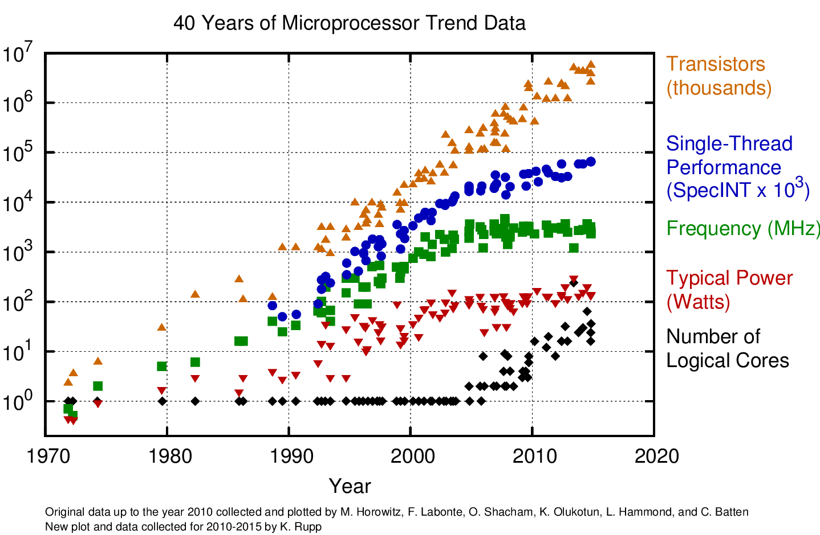
The Free Lunch is Over
Vectorization
The Free Lunch
Parallelization
https://www.karlrupp.net/2015/06/40-years-of-microprocessor-trend-data/

Slide 8
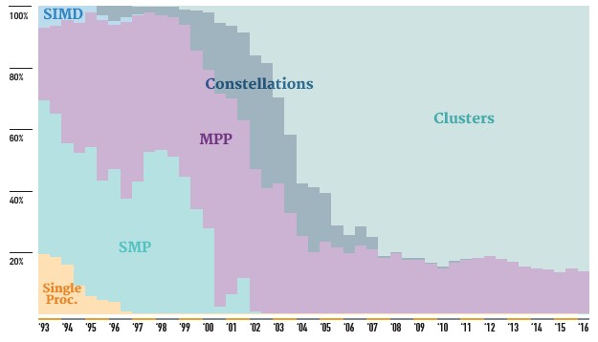
Top 500 Supercomputers
https://www.top500.org
https://www.nextplatform.com/2016/06/20/china-topples-united-states-top-supercomputer-user/

Slide 9
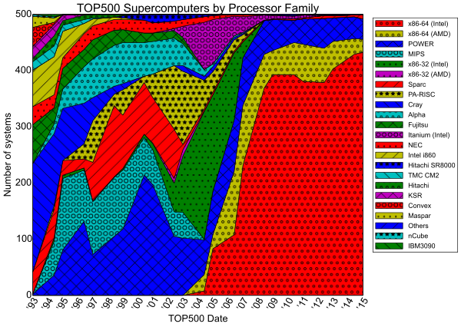
Why Talk About Intel Architecture?
https://www.revolvy.com/page/TOP500

Slide 10
Outline
Motivation
HPC Cluster
Compute
Memory
Disk
Emerging Architectures

Slide 11
Zoom In On A Cluster
A cluster is just connected collection of computers called nodes
A single-unconnected node is usually called a server
Entire clusters and stand-alone servers are sometimes referred to as machines

Slide 12
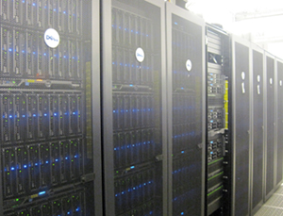
Parallel Computers
HPC Cluster
A collection of servers connected to form a single entity
Each is essentially a self-contained computer
OS with CPU, RAM, hard drive, etc.
Stored in racks in dedicated machine rooms
Connected together via (low latency) interconnects
Ethernet < Infiniband, OPA (Intel’s Omi-Path Architecture)
Connected to storage
Vast majority of HPC systems
SMP System
Symmetric Multi-Processing
CPUs all share memory – essentially one computer
Expensive and serve unique purpose
Huge memory and huge OpenMP jobs
Princeton’s Della Cluster

Slide 13
Basic Cluster Layout
Compute Nodes
Scheduler
ssh
Your Laptop
Login Node(s)
Shared Storage

Slide 14
Nodes Are Discrete Systems
Memory address space
Range of unique addresses
Separate for each node
Can’t just access all memory in cluster
Core
Core
Memory
Core
Core
Memory
Core
Core
Core
Core
Network
Core
Core
Memory
Core
Core
Memory
Core
Core
Core
Core
Each node has a separate address space

Slide 15
Clusters With Accelerators
Accelerators: GPUs or Xeon Phi (KNC, KNL)
Programmable with MPI + x
Where x = OpenMP, OpenACC, CUDA, …
Or x = OpenMP + CUDA, …
Increase computational power
Increase FLOPS / Watt
Top500.org
Shift toward systems with accelerators a few years ago
GPU / KNL
GPU / KNL
GPU / KNL
GPU / KNL

Slide 16
Outline
Motivation
HPC Cluster
Compute
Memory
Disk
Emerging Architectures

Slide 17
Multicore Processors
(Most) modern processors are multicores
Intel Xeon
IBM Power
AMD Opteron
ARM processors
Mobile processors
Most have vector units
Most have multiple cache levels
Require special care to program (multi-threading, vectorization, …)
Free lunch is over!
Instruction set
x86_64 – Intel and AMD
Power, ARM, NVIDIA, etc have different instruction sets
Intel Skylake Architecture

Slide 18
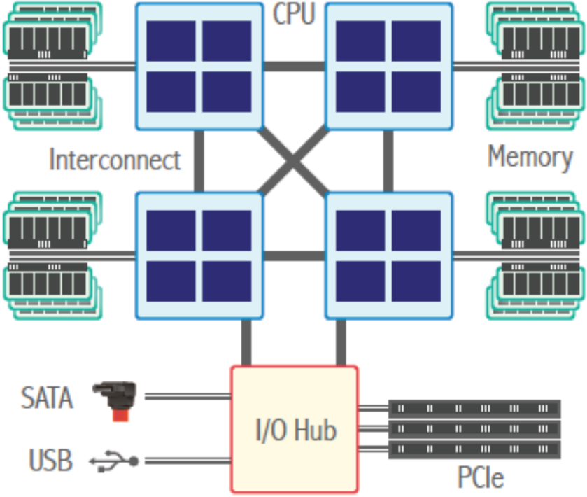
Motherboard Layout
Typical nodes have 1, 2, or 4 Processors (CPUs)
1: laptop/desktops/servers
2: servers/clusters
4: high end special use
Each processor is attached to a socket
Each processor has multiple cores
Processors connected via interconnect
Memory associated with processor
Programmer sees single node memory address space
Processor
Core
Core
Core
Core
Interconnect
Intel: QPI/UPI
AMD: HT

Slide 19
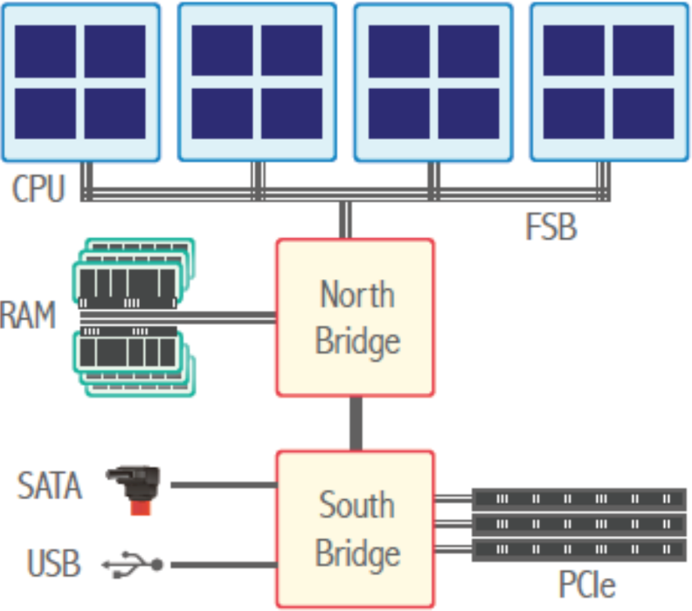
Motherboard Layouts
Elmer / Tuura /
Lefebvre
Intel QPI/UPI,
AMD HT
Symmetric MultiProcessing (SMP)
front side bus (FSB) bottlenecks in SMP systems, device-to-memory bandwidth via north bridge, north bridge to RAM bandwidth limitations.
Non-Uniform Memory Access (NUMA)
physical memory partitioned per CPU, fast interconnect to link CPUs to each other and to I/O.
Remove bottleneck but memory is no longer uniform – 30-50% overhead to accessing remote memory, up to 50x in obscure multi-hop systems.

Slide 20
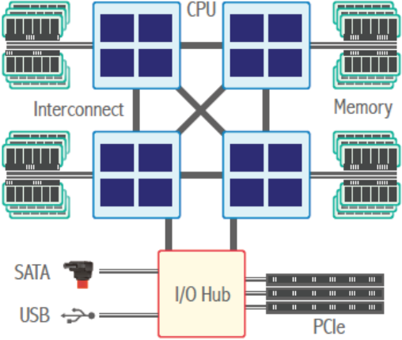
Example: Intel Skylake CPU
UPI, PCIe, DMI
Core Definition (Jarp):
“A complete ensemble of execution logic, and cache storage as well as register files plus instruction counter (IC) for executing a software process or thread.”
Memory Controller
UPI – Intel UltraPath Interconnect
PCIe – Peripheral Component Interconnect Express
DMI – Direct Media Interface
DDR – Double Data Rate
Core
Core
Memory
Controller
DDR
Core
Core
Core
Core
Core
Core
Core
Lefebvre

Slide 21
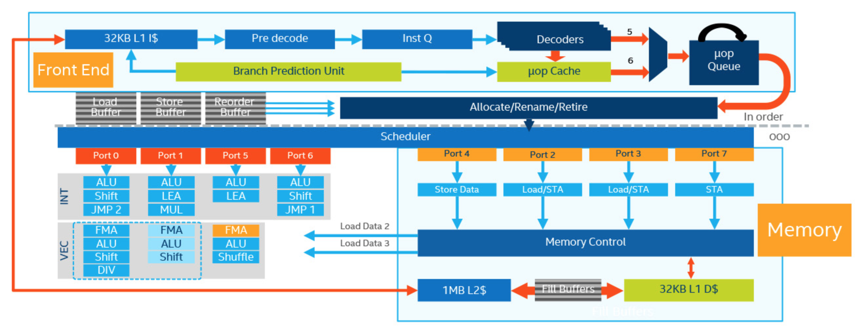
Skylake Core Microarchitecture
Too much!
Key Components:
Control logic
Register file
Functional Units
ALU (arithmetic and logic unit)
FPU (floating point unit)
Data Transfer
Load / Store

Slide 22
Vectorization Terminology
SIMD: Single Instruction Multiple Data
New generations of CPUs have new capabilities
Each core has VPUs and vector registers
Machine (assembly) commands that take advantage of new hardware
Called “instruction set”
E.g. Streaming SIMD Extensions (SSE) & AVX: Advanced Vector Extension (AVX)
Scalar (SISD)
Vector (SIMD)
a[i]
a[i]
a[i+1]
a[i+2]
a[i+3]
At inner-most loop level
+
+
for (int i=0; i<N; i++) {
c[i]=a[i]+b[i]; }
b[i]
b[i]
b[i+1]
b[i+2]
b[i+3]
=
=
a[i]+b[i]
a[i]+b[i]
a[i+1]+b[i+1]
a[i+2]+b[i+2]
a[i+3]+b[i+3]
One operation
One result
One operation
Multiple results

Slide 23

HPC Performance Metrics
FLOP = Floating-point Operation
FLOPs = Floating-point Operations
FLOPS = Floating-point Operations Per Second
Often FLOP/sec to avoid ambiguity
FLOPS/$
FLOPS/Watt
Bandwidth: GB/s
Calculation for single processor
Usually Double Precision (64-bit)
FLOPS = (Clock Speed) *(Cores)*(FLOPs/cycle)
N.B. - not to be confused with a Hollywood flop!
Notes:
1999 Film
Lost ~100 million

Slide 24
Intel Xeon (Server) Architecture Codenames
Number of FLOP/s depends on the chip architecture
Double Precision (64 bit double)
Nehalem/Westmere (SSE):
4 DP FLOPs/cycle: 128-bit addition + 128-bit multiplication
Ivybridge/Sandybridge (AVX)
8 DP FLOPs/cycle: 256-bit addition + 256-bit multiplication
Haswell/Broadwell (AVX2)
16 DP FLOPs/cycle: two, 256-bit FMA (fused multiply-add)
KNL/Skylake (AVX-512)
32 DP FLOPs/cycle: two*, 512-bit FMA
Cascade Lake (AVX-512 VNNI with INT8)
32 DP FLOPs/cycle: two, 512-bit FMA
FMA = (a × b + c)
Twice as many if single precision (32-bit float)
*Some Skylake-SP have only one
Notes:
Intel Deep Learning Boost (VNNI) provides significant, more efficient deep learning inference acceleration
Combines three AVX-512 instructions (VPMADDUBSW, VPMADDWD, VPADDD) into a single VPDPBUSD operation

Slide 25
Outline
Motivation
HPC Cluster
Compute
Memory
Layout
Cache
Performance
Disk
Emerging Architectures

Slide 26
Memory Hierarchy
Dual Socket Intel Xeon CPU
CPU 1
CPU 2
Main Memory (DRAM)
Main Memory (DRAM)
L2
L3
L3
L2
Core
1
L1
L1
Core
1
Core
2
L1
L2
L2
L1
Core
2
…
…
Core
n
L1
L2
L2
L1
Core
n
UPI
 | Registers | L1 Cache | L2 Cache | L3 Cache | DRAM | Disk
Speed | 1 cycle | ~4 cycles | ~10 cycles | ~30 cycles | ~200 cycles | 10ms
Size | < KB per core | ~32 KB per core | ~256 KB per core | ~35 MB per socket | ~100 GB per socket | TB
Notes:
DDR4 – Double data rate 4th generation (Synchronous dynamic RAM)
UPI – UltraPath Interconnect (Intel) Skylake shifted more L2 cache from shared L3 cache (L2 ~1MB)

Slide 27
Does It Matter?
Gap grows at 50% per year!
If your data is served by RAM and not caches it doesn’t matter if you have vectorization.
To increase performance, try to minimize memory footprint.
http://web.sfc.keio.ac.jp/~rdv/keio/sfc/teaching/architecture/architecture-2008/hennessy-patterson/Ch5-fig02.jpg
Notes:
Memory gap increases…
What do you think should require more attention?

Slide 28
Outline
Motivation
HPC Cluster
Compute
Memory
Disk
Types
Filesystems
Emerging Architectures

Slide 29
File I/O
“A supercomputer is a device for turning compute-bound problems into I/O-bound problems.”
-- Ken Batcher, Emeritus Professor of Computer Science at Kent State University

Slide 30
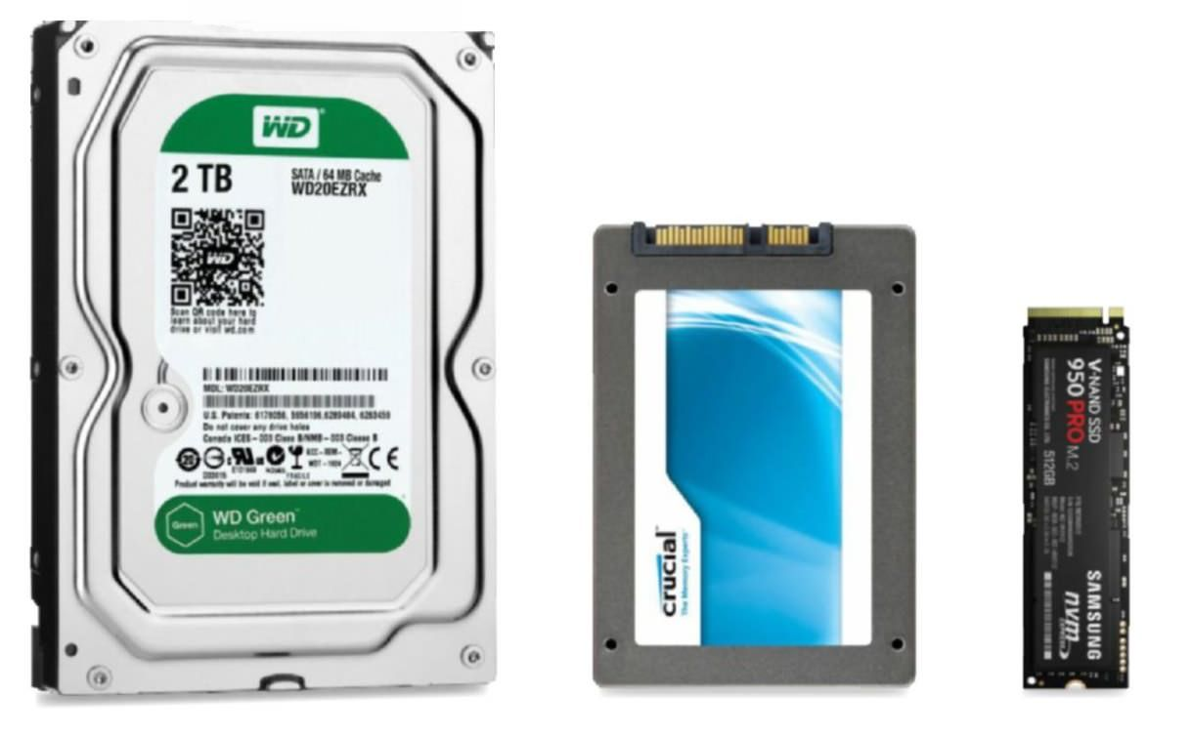
Types of Disk
Hard Disk Drive (HDD)
Traditional Spinning Disk
Solid State Drives (SSD)
~5x faster than HDD
Non-Volatile Memory Express (NVMe)
~5x faster than SSD
Photo Credit: Maximum PC

Slide 31
Types of Filesystems - NFS
NFS – Network File System
Simple, cheap, and common
Single filesystem across network
Not well suited for large throughput
Head node
Storage
Comp node 001
Storage
Comp node 002
NFS Server
...
...
Comp node N
Storage
≤ 8 storage devices

Slide 32
Parallel Filesystems
GPFS (General Parallel Filesystem – IBM)
Designed for parallel read/writes
Large files spread over multiple storage devices
Allows concurrent access
Significantly increase throughput
Lustre
Similar idea
Different implementation
Parallel I/O library in software
Necessary for performance realization
Head node
Object Storage
Storage
Comp node 001
File A 1/3
Storage
Comp node 002
...
File A 2/3
...
File A
Comp node N
Storage
File A 3/3
GPFS Servers
1,000s of storage devices

Slide 33
Outline
Motivation
HPC Cluster
Compute
Memory
Disk
Emerging Architectures
Xeon Phi
GPU
Cloud

Slide 34
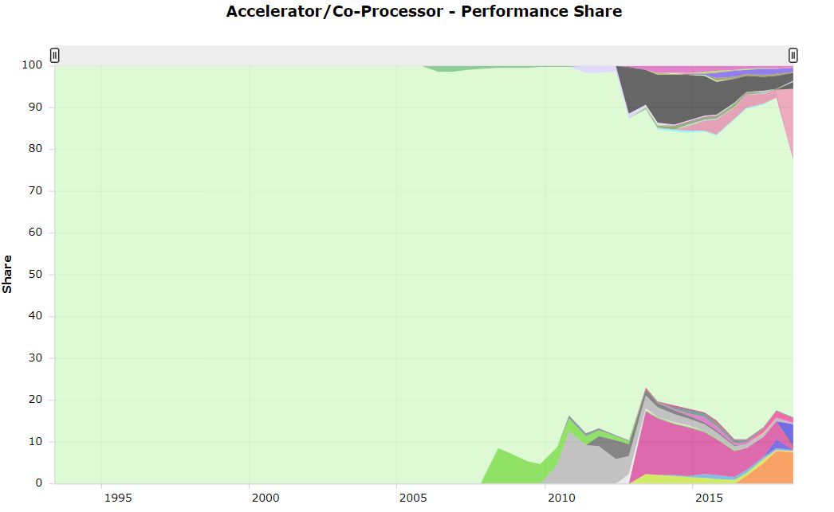
Emerging Architectures
The computing landscape changes rapidly
110 TOP500 systems have accelerators (June 2018)
https://www.top500.org/statistics
Notes:
NVIDIA P100, Intel Xeon Phi

Slide 35
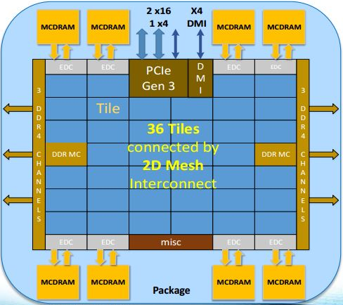
Intel Xeon Phi a.k.a. Intel MIC
MIC: Many Integrated Cores
x86-compatible multiprocessor architecture
Programmable using
C, C++, Fortran
MPI, OpenMP, OpenCL, …
Started as co-processor
Data travels over PCIe
Became a main processor in 2nd generation
Merged into Xeon line ~1 year ago
Intel announced end of Xeon Phi product line

Slide 36
GPUs
NVIDIA Volta V100
Graphic Processing Unit (GPU)
General Purpose GPU (GPGPU)
Exclusively a co-processor
Data travels over PCIe
NVLink is NVIDIAs new high-speed interconnect
Not compatible with x86 library
Programmable using:
CUDA, OpenCL
OpenACC, OpenMP
NVIDIA GPUs
Fermi/Kepler/Maxwell/Pascal/Volta

Slide 37
NVIDIA Volta (V100) GPU
Scalar Processors execute parallel thread instructions
Streaming Multiprocessors (SMs) each contain:
64 SP units (“CUDA cores”)
32 DP unit
32 GB device memory
Execution Model:
Notes:
LD/ST units
FP16 @ 2x SP rate
cc7.0:
TensorCore
4 warp schedulers
Each warp scheduler is dual issue capable
P100: 50 SM’s, 16GB
V100: 80 SM’s, 16/32GB

Slide 38
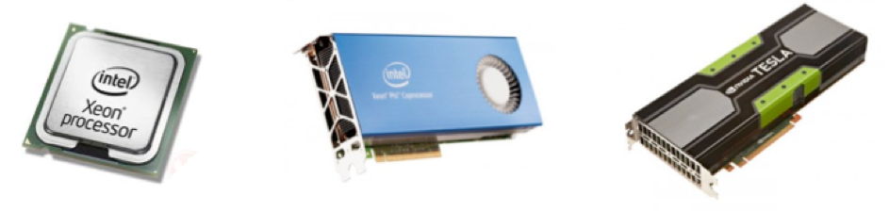
Accelerator Comparison
Lefebvre
 | Xeon Gold 5122 | Xeon Platinum 8280M | Xeon Phi 7290F | NVIDIA V100
Cores | 4 | 28 | 72 | 84 SMs
Logical Cores | 8 | 56 | 288 | 5120 cores
Clock rate | 3.6 – 3.7 GHz | 2.5 – 3.8 GHz | 1.5-1.7 GHz | 1530 MHz
Theoretical GFLOPS (double) | 460.8 | 2240 | 3456 | 7450
SIMD width | 512 bit | 512 bit | 512 bit | Warp of 32 threads
Memory | -- | -- | 16 GB MCDRAM 384 GB DDR4 | 32 GB
Memory B/W | 127.8 GB/s | 127.8 GB/s | 400+ GB/s (MCDRAM) 115.2 GB/s | 900 GB/s
Approx. Unit Price | $1,200 | $12,000 | $3,400 | $9,000
Notes:
https://www.v-t.co.jp/product/wp-content/uploads/sites/2/2017/09/Skylake-SP_Feature_092017.pdf
Choice of xeon is arbitrary (actually depends on the data I could find)

Slide 39
Demystifying the Cloud
“Regular” computers, just somewhere else
Provide users with remote virtual machines or containers
Can be used for anything:
Mobile-services, Hosting websites, Business Application, …
Data Analysis, High Performance Computing
Providers
Major players: Amazon, Google, Microsoft, HP, IBM, Salesforce.com, …
Lots of others
M. Lefebvre

Slide 40
Cloud Computing
Advantages:
Potentially lower cost:
Pay as you go
Potentially lower cost:
Save on sysadmins and infrastructure
Potentially lower cost:
Economy of scale: providers
Scaling up or down as needed
Can be used to run overflow from a regular data center
Access to a wide range of hardware
Additional challenges
Data movement
Expensive and time consuming
Security, privacy, …
M. Lefebvre
Notes:
Notice the “potentially”s

Slide 41
What We Didn’t Talk About
Microarchitecture details (ALU, FPU, pipelining…)
Memory bandwidth
Cache lines and cache coherence
IBM (Power) or AMD
FPGAs

Slide 42
Resources & References
Very nice glossary: https://cvw.cac.cornell.edu/main/glossary
J. Hennessy, D. Patterson, Computer Architecture: A Quantitative Approach, 6th edition (2017), ISBN 978-0128119051
U. Drepper, What Every Programmer Should Know About Memory, http://people.redhat.com/drepper/cpumemory.pdf
NVIDIA Volta Architecture Whitepaper https://images.nvidia.com/content/volta-architecture/pdf/volta-architecture-whitepaper.pdf
Notes:
Bit.ly/2019-comp-arch

